Slide 1
UNIT-IV ALGREBRIC STRUCTURES

Slide 2
DISCLAIMER
The slides are adapted from Kenneth H. Rosen, C. L. Liu, MIT Oxford Press Lectures, and Cornell University presentation slides.

Slide 3
WHAT IS AN ALGEBRIC STRUCTURE?
Comes in the domain of Abstract Algebra.
Abstract algebra is the study of algebraic structures. Such a structure consists of a set together with one or more binary operations, which are required to satisfy certain axioms.
Like addition, subtraction, multiplication, division, modulus and many more..
The elements of the set can be numbers, abstract symbols as well , we focus on the properties the elements possess, when certain operations are applied on them.
Why CARE→ Draw generalization among different systems and properties.
Discover new system with similar properties
Prove basic theorems about all systems possessing same properties.

Slide 4
APPLICATIONS OF ALGEBRIC STRUCTURES IN COMPUTER SCIENCE
Number theory and dynamical flow-systems
The mathematics of random number generators
Finite Fields in Cryptography
Error Correcting and Block Codes in Communication Systems
Coding Theory
Cyclotomy and cyclic codes in Software Engineering
Basic shape primitives in Computer Graphics and Digital Image Processing
Finite Automata and Language generators

Slide 5
ALGEBRAIC SYSTEMS
N = {1,2,3,4,…..∝ } = Set of all natural numbers.
Z = { 0, ± 1, ± 2, ± 3, ± 4 , ….. ∝} = Set of all integers.
Q = Set of all rational numbers.
R = Set of all real numbers.
Binary Operation: The binary operator * is said to be a binary operation (closed operation) on a non empty set A, if
a * b ∈ A for all a, b ∈ A (Closure property).
Ex: The set N is closed with respect to addition and multiplication
but not w.r.t subtraction and division.
Algebraic System: A set ‘A’ with one or more binary(closed) operations defined on it is called an algebraic system.
Ex: (N, + ), (Z, +, – ), (R, +, . , – ) are algebraic systems.

Slide 6
PROPERTIES FOR SET WITH ONE OPERATION
Commutative: Let * be a binary operation on a set A.
The operation * is said to be commutative in A if
a * b= b * a for all a, b in A
Associativity: Let * be a binary operation on a set A.
The operation * is said to be associative in A if
(a * b) * c = a *( b * c) for all a, b, c in A
Identity: For an algebraic system (A, *), an element ‘e’ in A is said to be an identity element of A if
a * e = e * a = a for all a ∈ A.
Note: For an algebraic system (A, *), the identity element, if exists, is unique.
Inverse: Let (A, *) be an algebraic system with identity ‘e’. Let a be an element in A. An element b is said to be inverse of A if
a * b = b * a = e

Slide 7
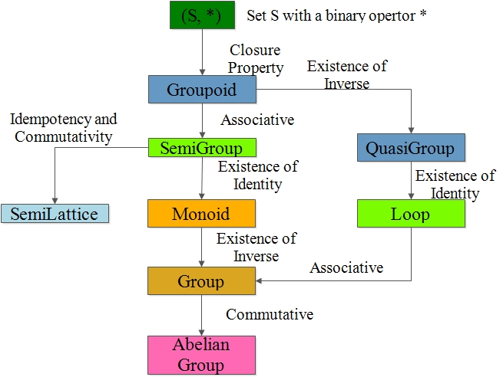
ALGEBRIC STRUCTURES FOR SET WITH ONE OPERATION

Slide 8
SEMI GROUP
Semi Group: An algebraic system (A, *) is said to be a semi group if
1. * is closed operation on A.
2. * is an associative operation, for all a, b, c in A.
Ex. (N, +) is a semi group.
Ex. (N, .) is a semi group.
Ex. (N, – ) is not a semi group.
Monoid: An algebraic system (A, *) is said to be a monoid if the following conditions are satisfied.
1) * is a closed operation in A.
2) * is an associative operation in A.
3) There is an identity in A.

Slide 9
MONOID
Ex. Show that the set ‘N’ is a monoid with respect to multiplication.
Solution: Here, N = {1,2,3,4,……}
1. Closure property : We know that product of two natural numbers is again a natural number.
i.e., a.b = b.a for all a,b ∈ N
∴ Multiplication is a closed operation.
2. Associativity : Multiplication of natural numbers is associative.
i.e., (a.b).c = a.(b.c) for all a,b,c ∈ N
3. Identity : We have, 1 ∈ N such that
a.1 = 1.a = a for all a ∈ N.
∴ Identity element exists, and 1 is the identity element.
Hence, N is a monoid with respect to multiplication.

Slide 10
GROUP
Group: An algebraic system (G, *) is said to be a group if the following conditions are satisfied.
1) * is a closed operation.
2) * is an associative operation.
3) There is an identity in G.
4) Every element in G has inverse in G.
Abelian group (Commutative group): A group (G, *) is
said to be abelian (or commutative) if
a * b = b * a for all a, b ε G.

Slide 11
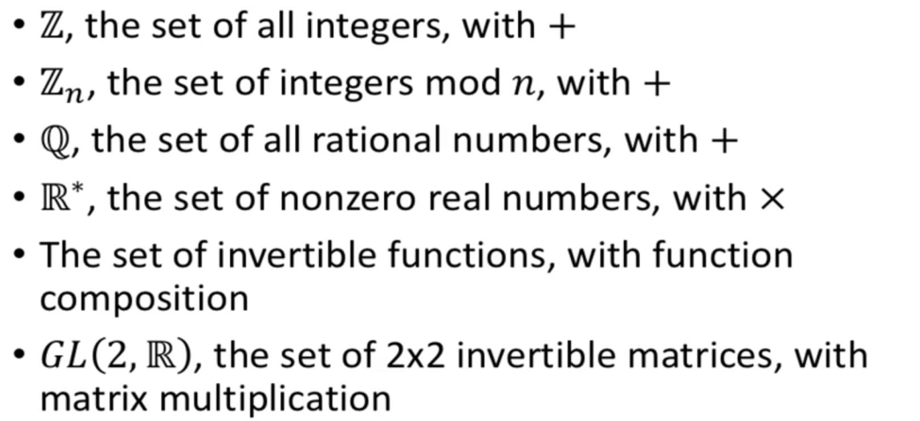
EXAMPLES
SNISTFORUM.COM

Slide 12
CANCELLATION LAWS IN GROUPS
In a Group (G, * ) the following properties hold good
1. Identity element is unique.
2. Inverse of an element is unique.
3. Cancellation laws hold good
a * b = a * c ⇒ b = c (left cancellation law)
a * c = b * c ⇒ a = b (Right cancellation law)
4. (a * b) ⁻¹ = b⁻¹ * a⁻¹
In a group, the identity element is its own inverse.

Slide 13
EX. SHOW THAT, THE SET OF ALL INTEGERS IS A GROUP WITH
RESPECT TO ADDITION.
Solution: Let Z = set of all integers.
Let a, b, c are any three elements of Z.
1. Closure property : We know that, Sum of two integers is again an integer.
i.e., a + b ∈ Z for all a,b ∈ Z
2. Associativity: We know that addition of integers is associative.
i.e., (a+b)+c = a+(b+c) for all a,b,c ∈ Z.
3. Identity : We have 0 ∈ Z and a + 0 = a for all a ∈ Z .
∴ Identity element exists, and ‘0’ is the identity element.
4. Inverse: To each a ∈ Z , we have – a ∈ Z such that
a + ( – a ) = 0
Each element in Z has an inverse.

Slide 14
CONTD.,
5. Commutativity: We know that addition of integers is commutative.
i.e., a + b = b +a for all a,b ∈ Z.
Hence, ( Z , + ) is an abelian group.

Slide 15
THEOREM
Ex. In a group (G, *) , Prove that the identity element is unique.
Proof :
a) Let e₁ and e₂ are two identity elements in G.
Now, e₁ * e₂ = e₁ …(1) (since e₂ is the identity)
Again, e₁ * e₂ = e₂ …(2) (since e₁ is the identity)
From (1) and (2), we have e₁ = e₂
∴ Identity element in a group is unique.

Slide 16
THEOREM
Ex. In a group (G, *) , Prove that the inverse of any element is unique.
Proof:
Let a ,b,c ∈G and e is the identity in G.
Let us suppose, Both b and c are inverse elements of a .
Now, a * b = e …(1) (Since, b is inverse of a )
Again, a * c = e …(2) (Since, c is also inverse of a )
From (1) and (2), we have
a * b = a * c
⇒ b = c (By left cancellation law)
In a group, the inverse of any element is unique.

Slide 17
FINITE GROUPS
Ex. Show that G = {1, -1} is an abelian group under multiplication.
Solution: The composition table of G is
. 1 – 1
1 1 – 1
– 1 – 1 1
1. Closure property: Since all the entries of the composition table are the elements of the given set, the set G is closed under multiplication.
2. Associativity: The elements of G are real numbers, and we know that multiplication of real numbers is associative.
3. Identity : Here, 1 is the identity element and 1∈ G.
4. Inverse: From the composition table, we see that the inverse elements of
1 and – 1 are 1 and – 1 respectively.

Slide 18
CONTD.,
Hence, G is a group w.r.t multiplication.
5. Commutativity: The corresponding rows and columns of the table are identical. Therefore the binary operation . is commutative.
Hence, G is an abelian group w.r.t. multiplication..

Slide 19
EX. SHOW THAT G = {1, ω, ω²} IS AN ABELIAN GROUP UNDER MULTIPLICATION.
WHERE 1, ω, ω² ARE CUBE ROOTS OF UNITY.
Solution: The composition table of G is
. 1 ω ω²
1 1 ω ω²
ω ω ω² 1
ω² ω² 1 ω
1. Closure property: Since all the entries of the composition table are the elements of the given set, the set G is closed under multiplication.
2. Associativity: The elements of G are complex numbers, and we know that multiplication of complex numbers is associative.
3. Identity : Here, 1 is the identity element and 1∈ G.
4. Inverse: From the composition table, we see that the inverse elements of
1 ω, ω² are 1, ω², ω respectively.

Slide 20
CONTD.,
Hence, G is a group w.r.t multiplication.
5. Commutativity: The corresponding rows and columns of the table are identical. Therefore the binary operation . is commutative.
Hence, G is an abelian group w.r.t. multiplication.

Slide 21
MORE ON FINITE GROUPS
In a group with 2 elements, each element is its own inverse
In a group of even order there will be at least one element (other than identity element) which is its own inverse
The set G = {0,1,2,3,4,…..m-1} is a group with respect to addition modulo m.
The set G = {1,2,3,4,….p-1} is a group with respect to multiplication
modulo p, where p is a prime number.
Order of an element of a group:
Let (G, *) be a group. Let ‘a’ be an element of G. The smallest integer n such that a^{n} = e is called order of ‘a’. If no such number exists then the order is infinite.

Slide 22
EXAMPLES
Ex. G = {1, -1, i, -i } is a group w.r.t multiplication.The order –i is a) 2 b) 3 c) 4 d) 1

Slide 23
SUB GROUPS
Def. A non empty sub set H of a group (G, *) is a sub group of G,
if (H, *) is a group.
Note: For any group {G, *}, {e, * } and (G, * ) are trivial sub groups.
Ex. G = {1, -1, i, -i } is a group w.r.t multiplication.
H₁ = { 1, -1 } is a subgroup of G .
H₂ = { 1 } is a trivial subgroup of G.
Ex. ( Z , + ) and (Q , + ) are sub groups of the group (R +).
Theorem: A non empty sub set H of a group (G, *) is a sub group of G iff
i) a * b ∈ H ∀ a, b ∈ H
ii) a⁻¹ ∈ H ∀ a ∈ H

Slide 24
SUBGROUPS
Proposition . If H is a nonempty finite subset of a group G and ab ∈ H for all a, b ∈ H, then H is a subgroup of G.
Example In the group ({1,−1, i,−i}, ・), the subset {1,−1} forms a subgroup because this subset is closed under multiplication
Example The group  is a subgroup of , is a subgroup of , and  is a subgroup of . (Remember that addition is the operation in all these groups.)
However, the set  = {0, 1, 2, . . .} of nonnegative integers is a subset of  but not a subgroup, because the inverse of 1, namely, −1, is not in  
The relation of being a subgroup is transitive. In fact, for any group G, the inclusion relation between the subgroups of G is a partial order relation.
SNISTFORUM.COM

Slide 25
MODULO SYSTEMS.
Addition modulo m ( +_{m} )
let m is a positive integer. For any two positive integers a and b
a +_{m} b = a + b if a + b < m
a +_{m} b = r if a + b ≥ m where r is the remainder obtained
by dividing (a+b) with m.
Multiplication modulo p ( ×_{p} )
let p is a positive integer. For any two positive integers a and b
a ×_{p} b = a b if a b < p
a ×_{p} b = r if a b ≥ p where r is the remainder obtained
by dividing (ab) with p.
Ex. 3 ×₅ 4 = 2 , 5 ×₅ 4 = 0 , 2 ×₅ 2 = 4

Slide 26
EXAMPLE
The set of complex numbers {1,−1,i,−i} under multiplication operation is a cyclic group.
There are two generators (i and –i)
as i=i,i^2=−1,i^3=−i,i^4=1, which covers all the elements of the group. Hence, it is a cyclic group
Similarly we can check for –i.
SNISTFORUM.COM

Slide 27
ORDER OF A GROUP
Definition. Let G be a group and let a ∈ G. If a^{k} = 1 for some k ≥ 1, then the smallest such exponent k ≥ 1 is called the order of a; if no such power exists, then one says that a has infinite order.
Proposition Let G be a group and assume that a ∈G has finite order k. If a^{n} = 1, then k | n. In fact, {n ∈ : a^{n} = 1} is the set of all the multiples of k.

Slide 28
CYCLIC GROUPS AND GENERATORS
Definition. If G is a group and a ∈ G, write
<a > = {a^{n} : n∈z } = {all powers of a } .
It is easy to see that <a > is a subgroup of G .
< a > is called the cyclic subgroup of G generated by a. A group G is called cyclic if there is some a ∈ G with G = < a >; in this case a is called a generator of G.
Proposition If G= <a > is a cyclic group of order n, then a^{k} is a generator of G if and only if gcd(k, n)= 1.
Corollary The number of generators of a cyclic group of order n is φ(n).

Slide 29
FINITE GROUPS
Proposition Let G be a finite group and let a ∈ G. Then the order of a is the number of elements in <a >.
Definition. If G is a finite group, then the number of elements in G, denoted by |G|, is called the order of G.

